Slide 1
Sex-Specific GWAS
Carrie Zhu

Slide 2
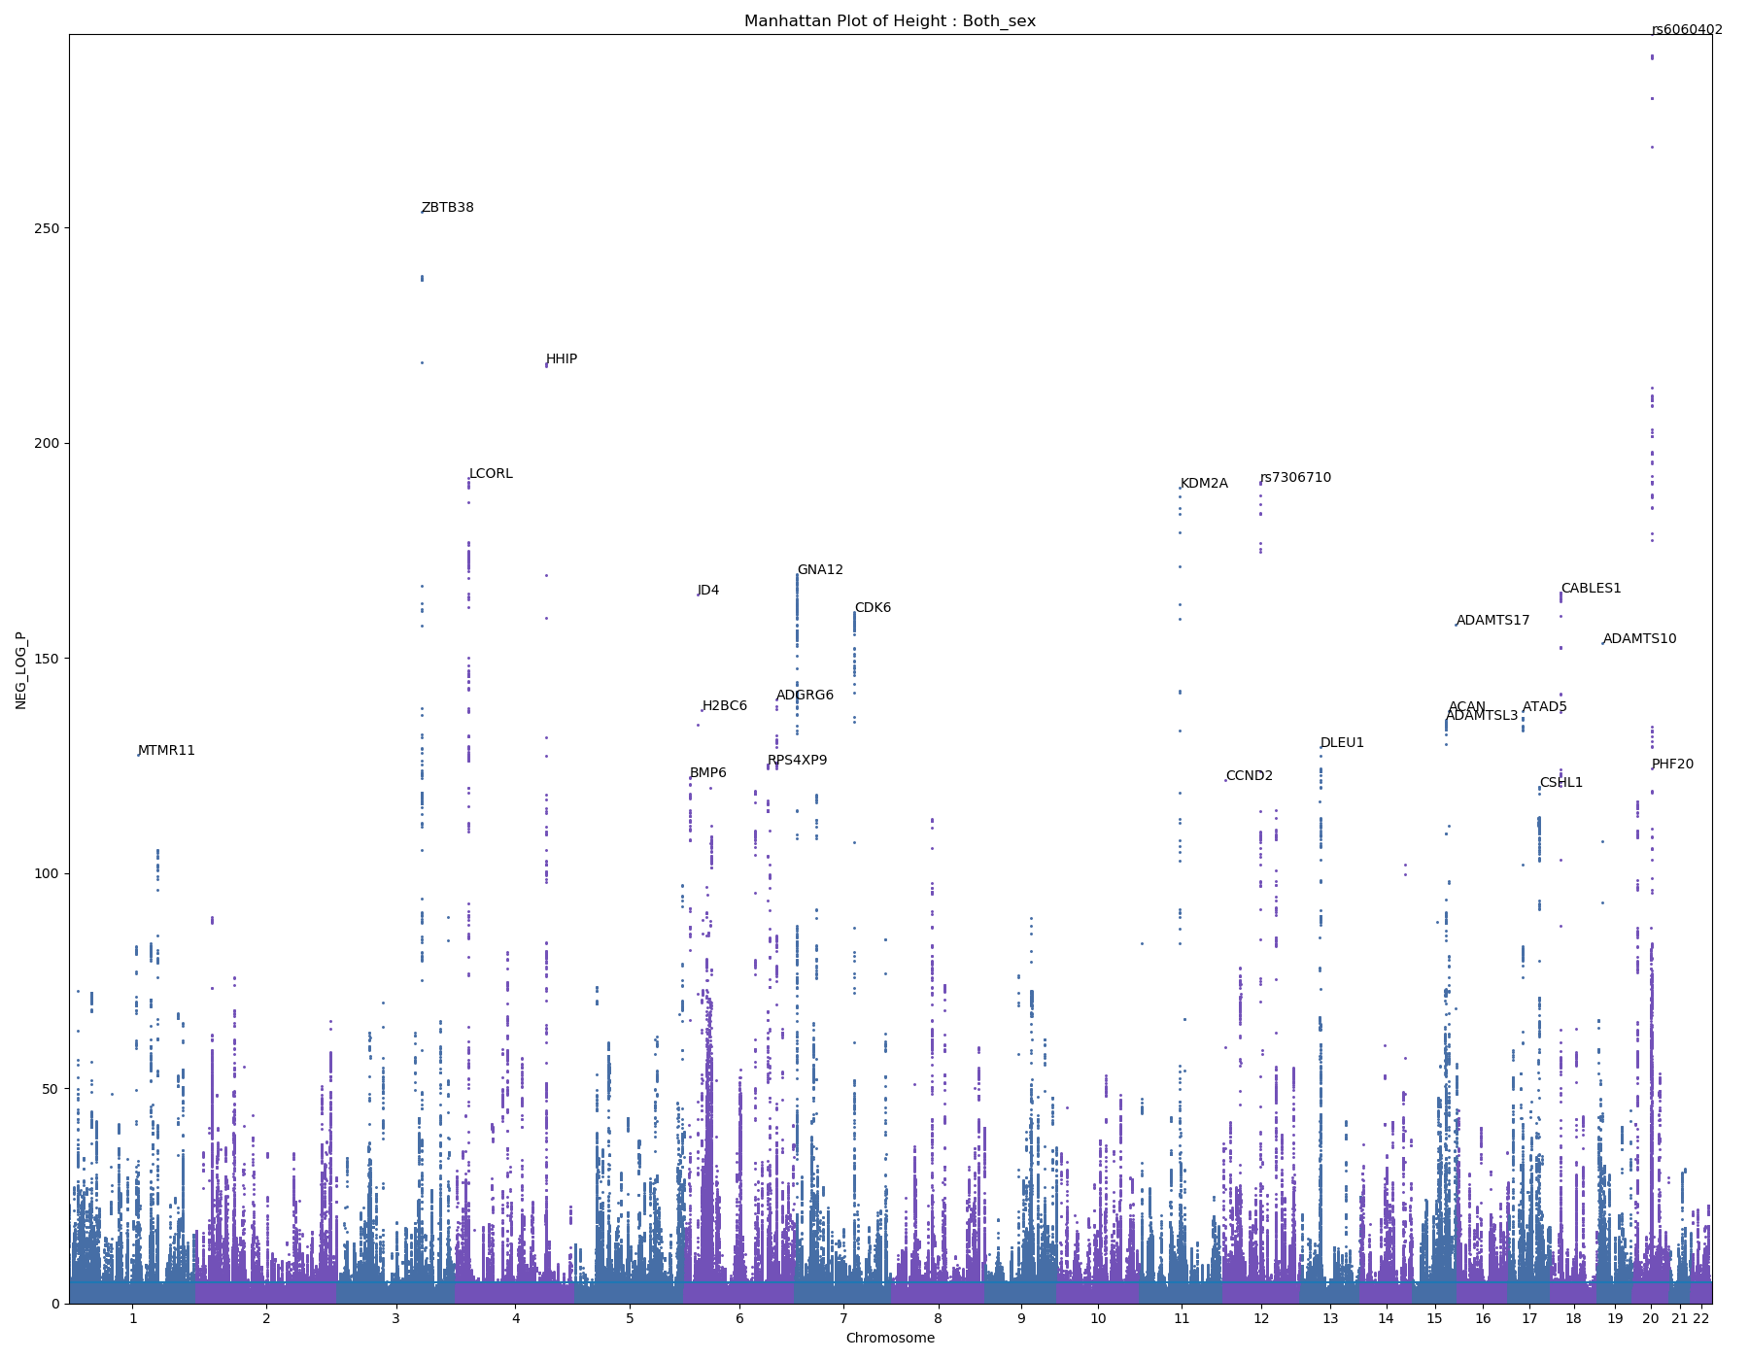
Height
429282 samples
ZBTB38: Stature Quantitative Trait Locus 10

Slide 3
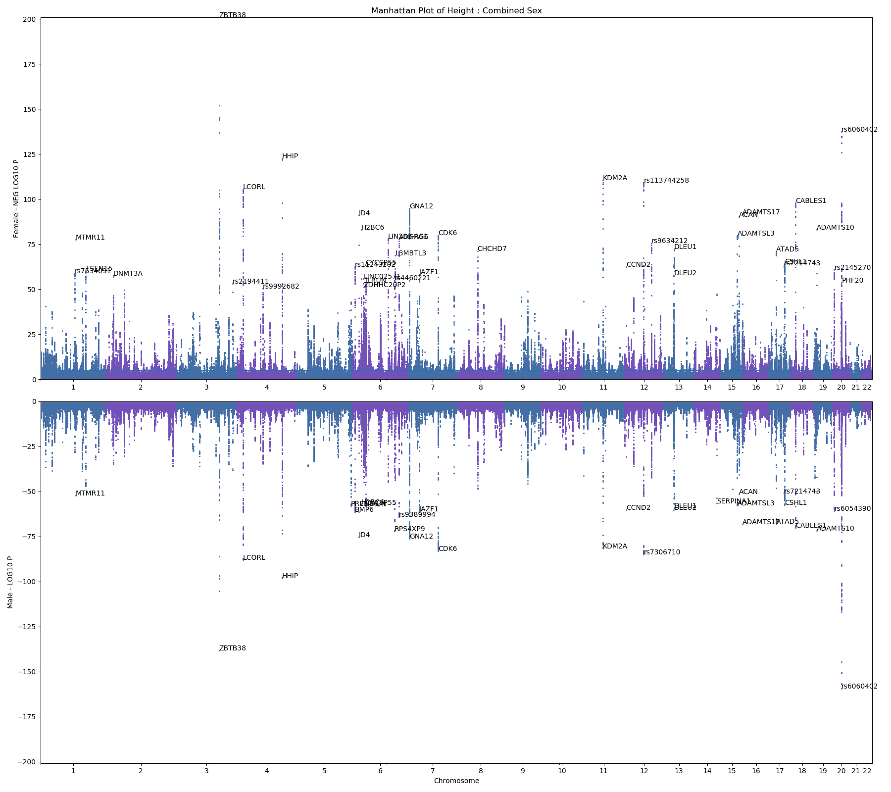
Height
Female – 232415 samples
Male – 196867 samples

Slide 4
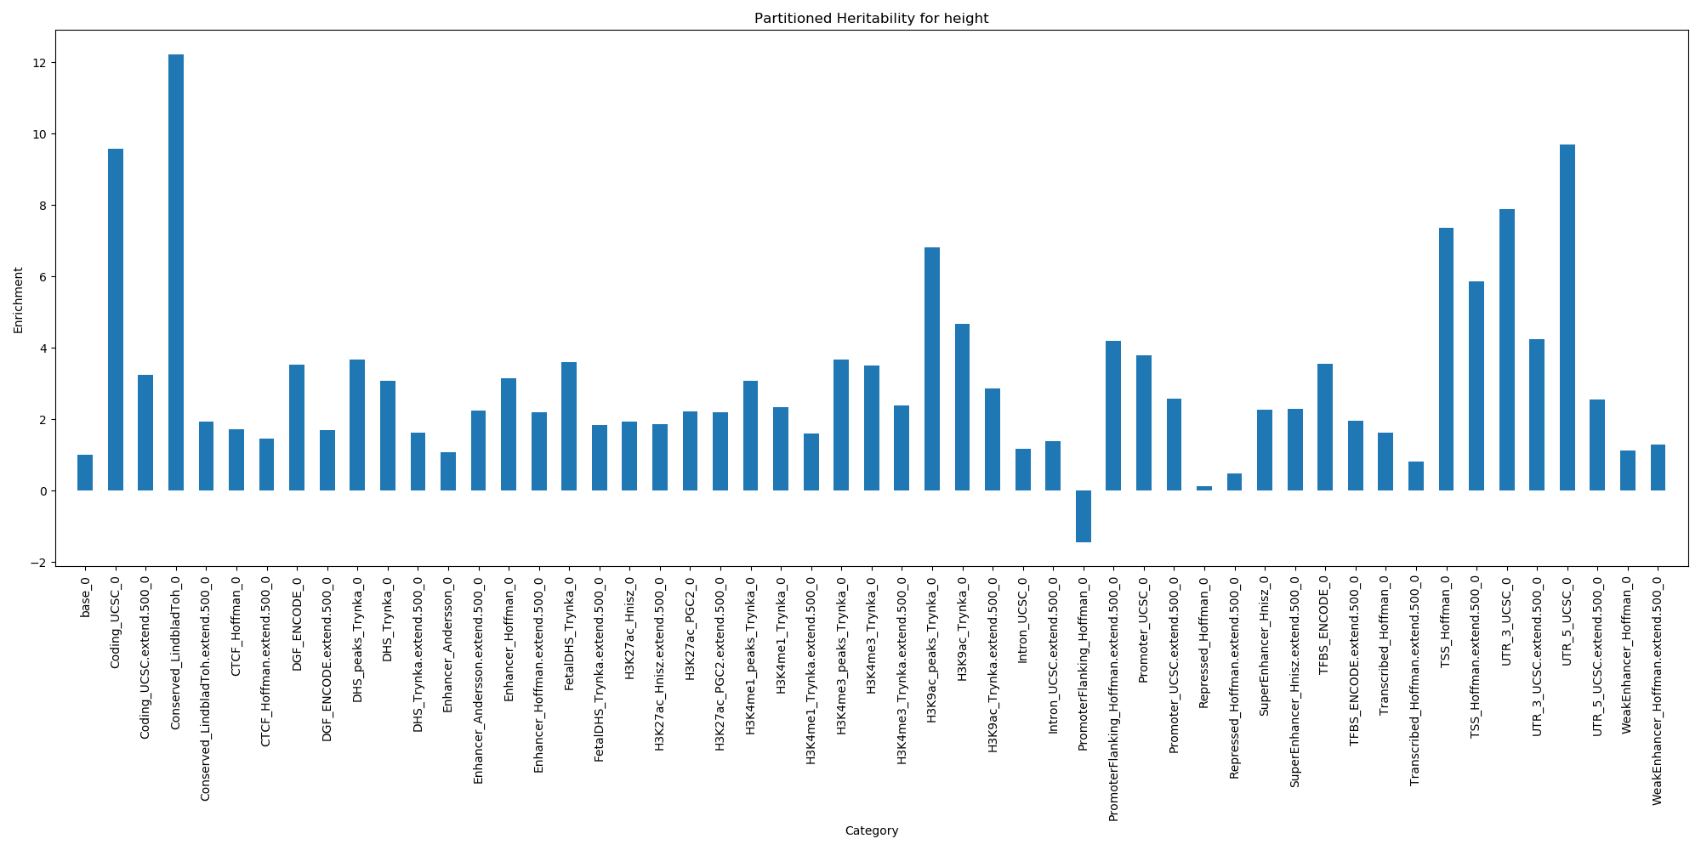
Partitioned Heritability - Height

Slide 5
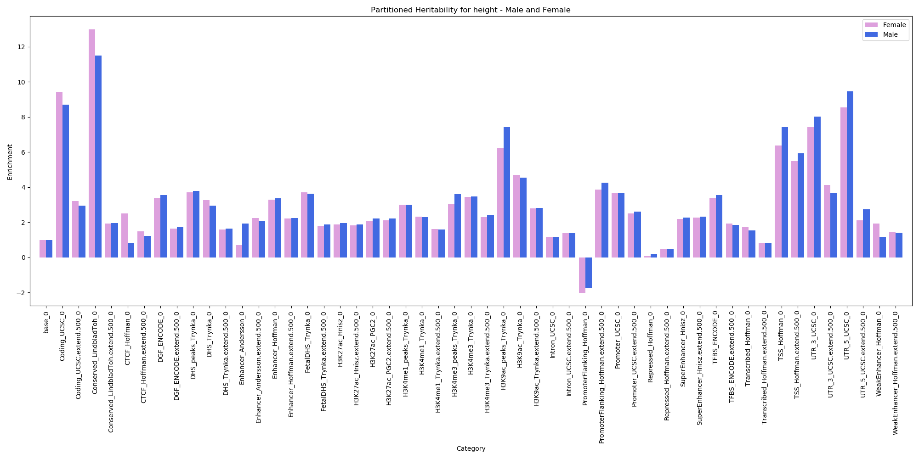
Partitioned Heritability – Height – Male and Female

Slide 6
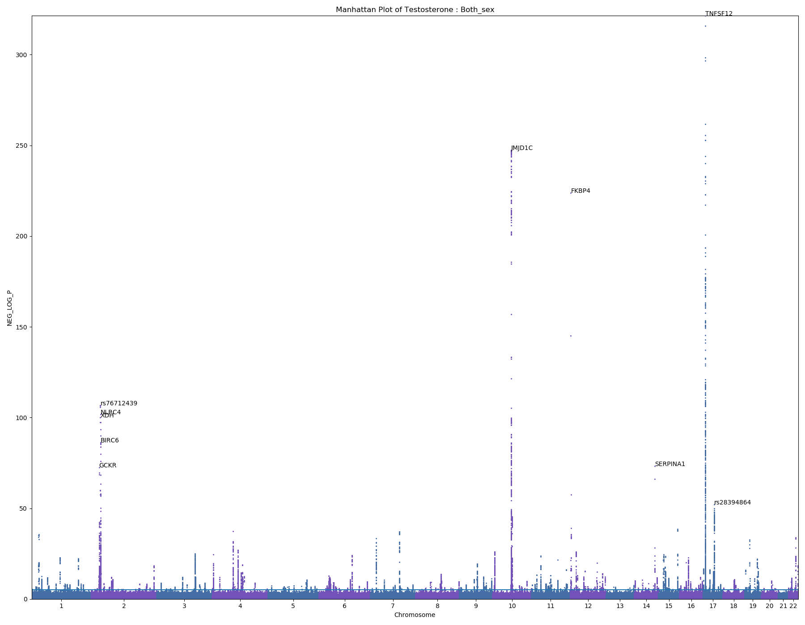
Testosterone
371438 samples

Slide 7
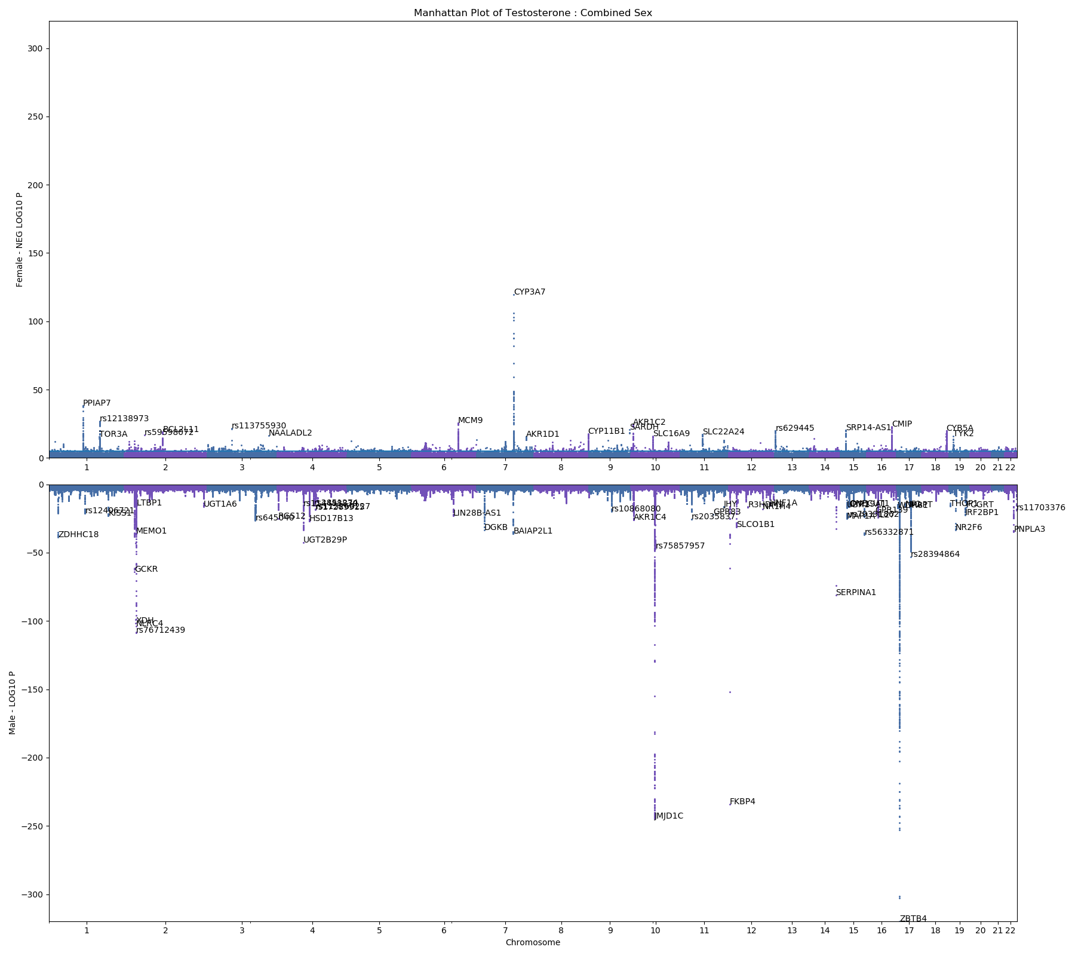
Testosterone
Female – 184982 samples
Paper: female-specific variants in: STAG3, POR, LIPE, UGT2B7, MCM9, TSBP1
MCM9: gamete formation
CYP3A7: drug metabolism; synthesis of cholesterol, steroids, lipids; hydroxylates testosterone
Male – 186456 samples
known testosterone-related genes (AR, JMJ1DC, and FAM9B)
JMJ1DC: participate in hormone recruitment to androgen-receptor target gene
FKBP4: androgen signaling pathway

Slide 8
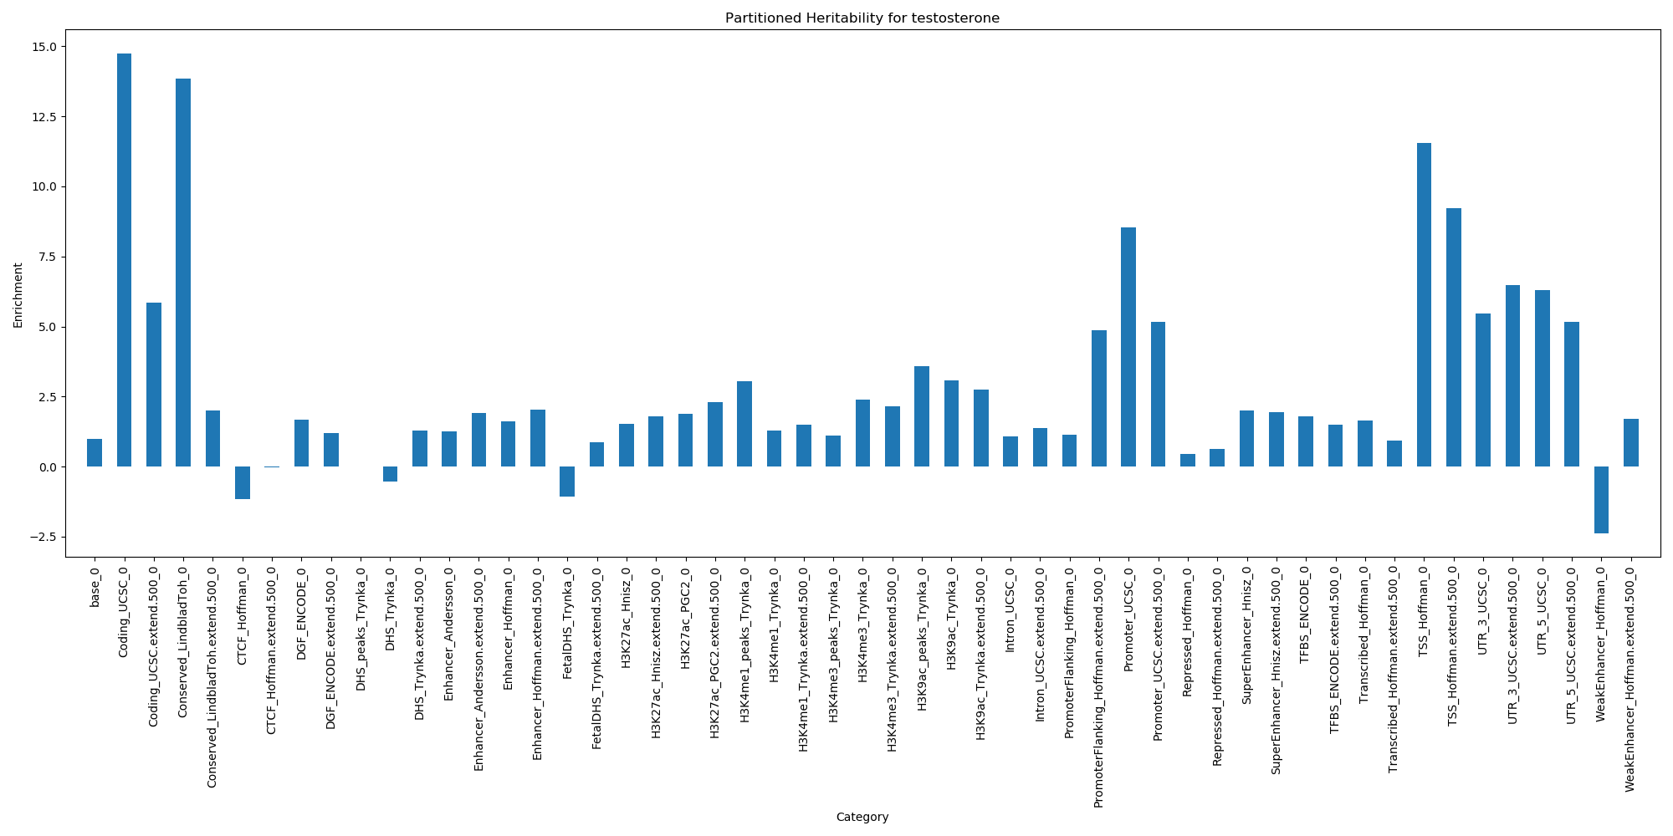
Partitioned Heritability - Testosterone

Slide 9
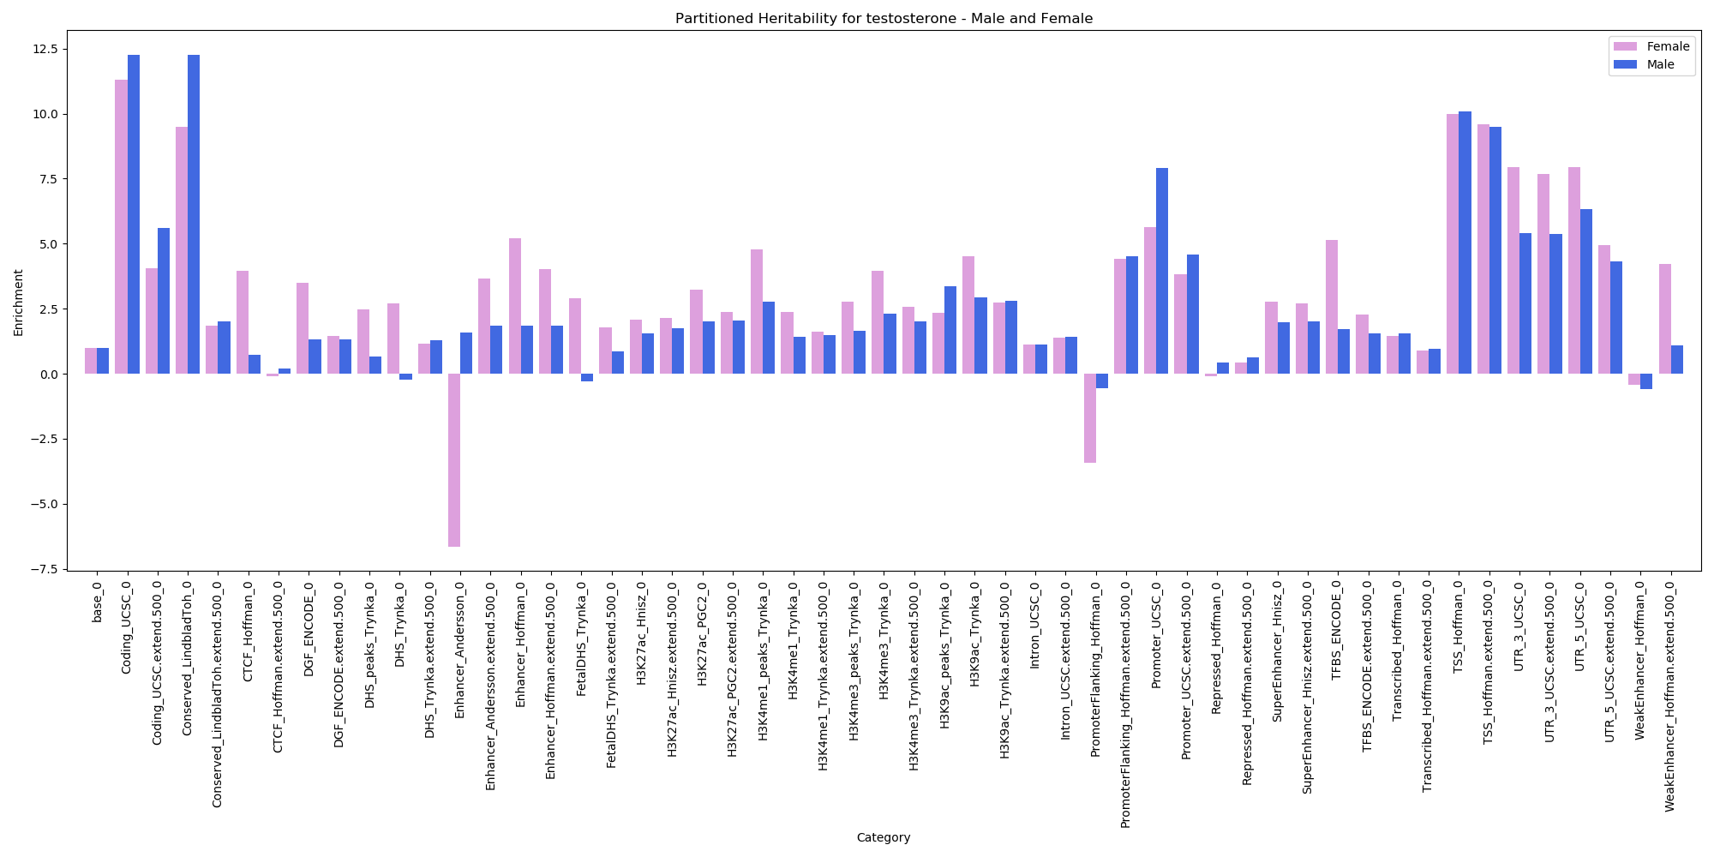
Partitioned Heritability – Testosterone – Male and Female

Slide 10
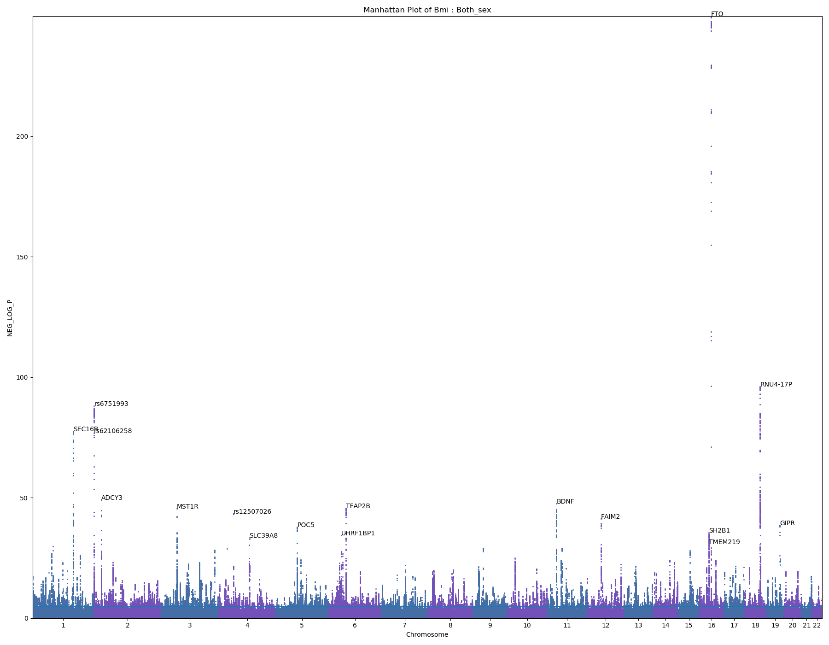
BMI
4288833 samples
FTO: Fat mass and obesity associated

Slide 11
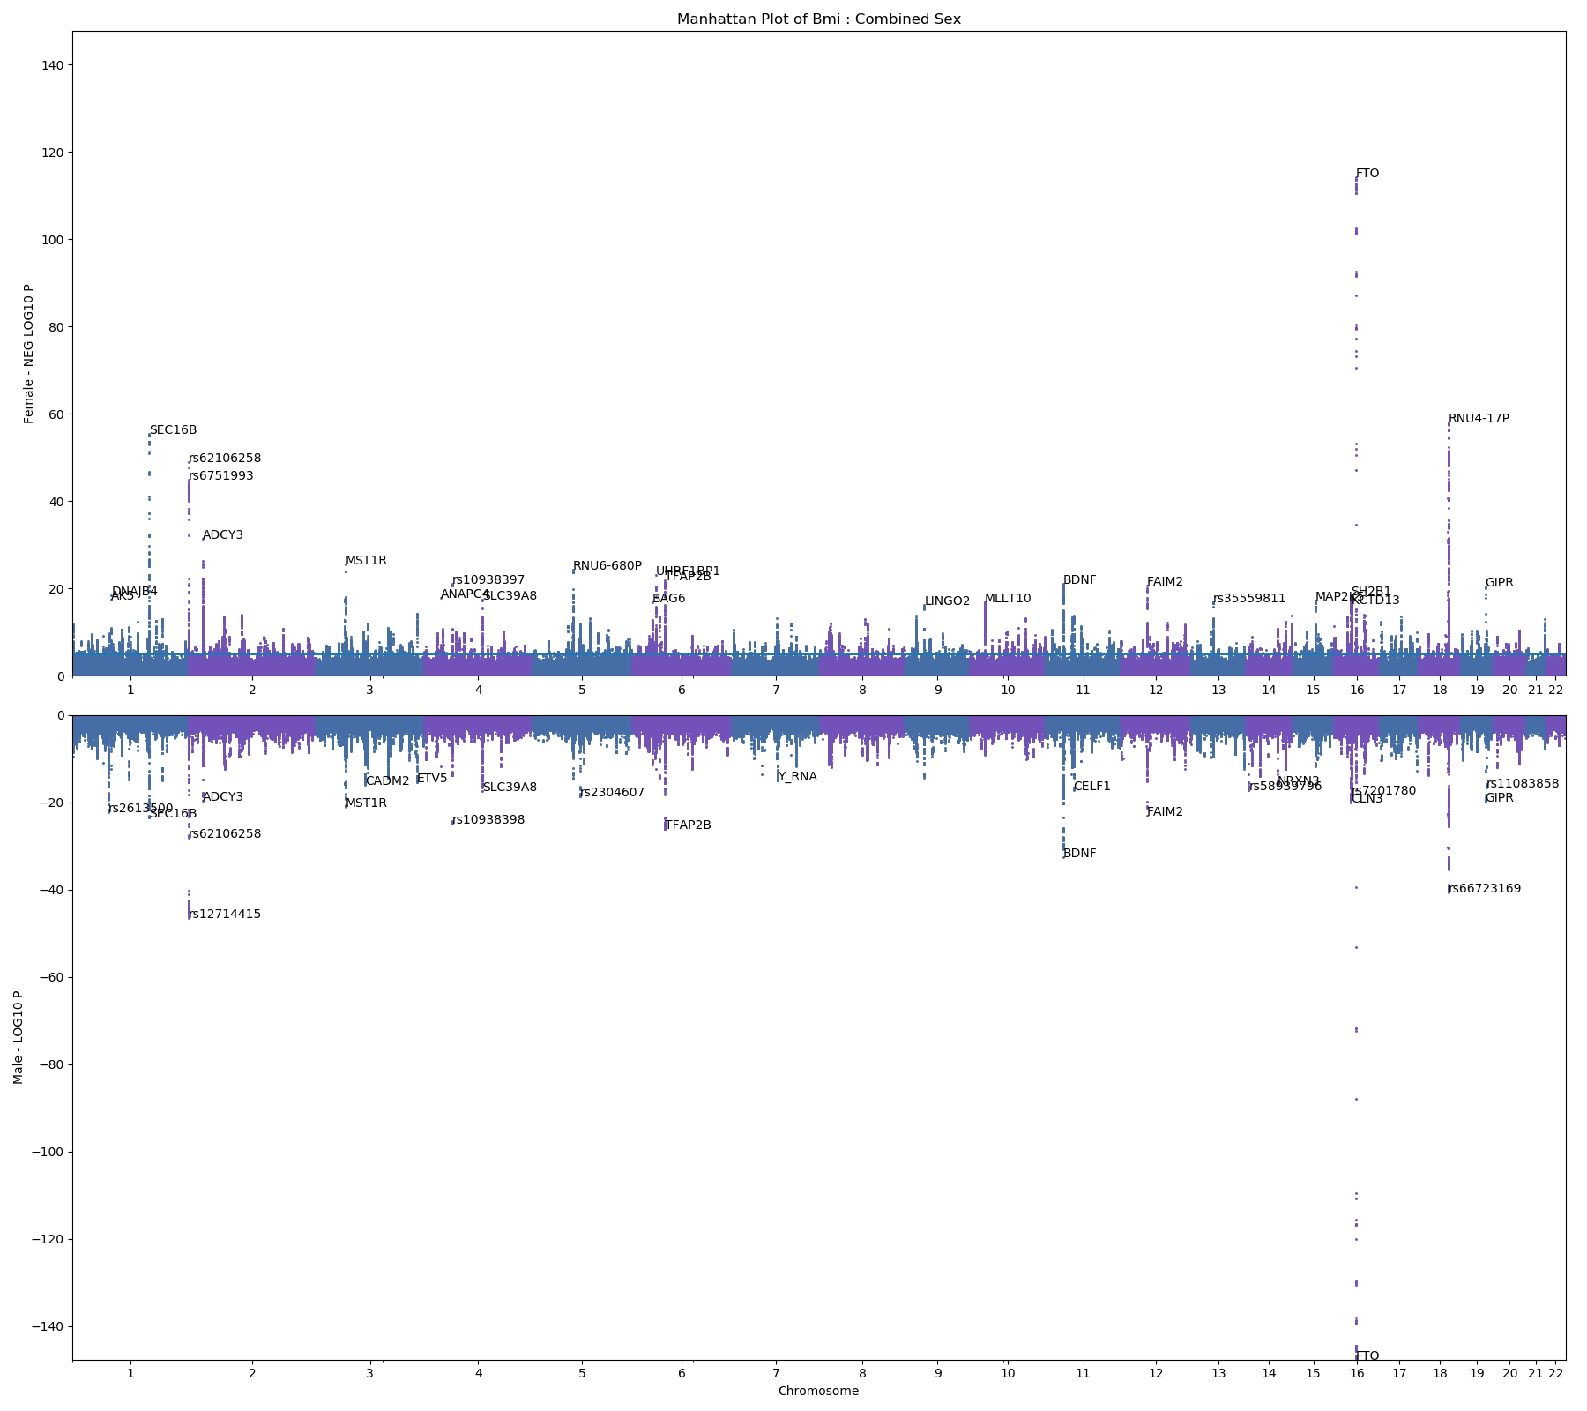
BMI
Female – 232173 samples
Male – 196660 samples

Slide 12
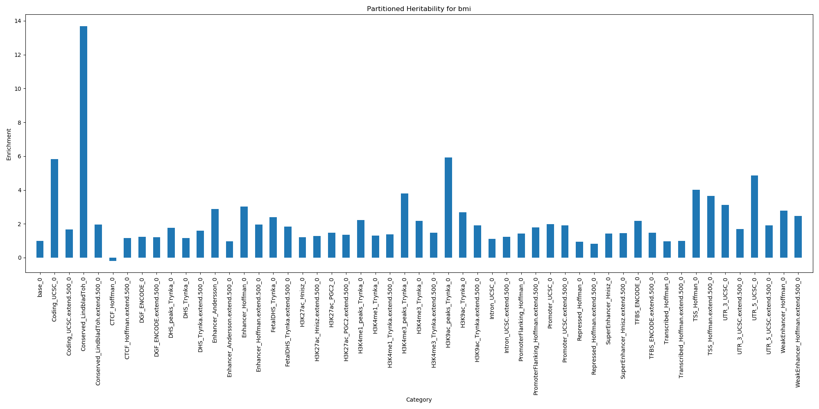
Partitioned Heritability - BMI

Slide 13
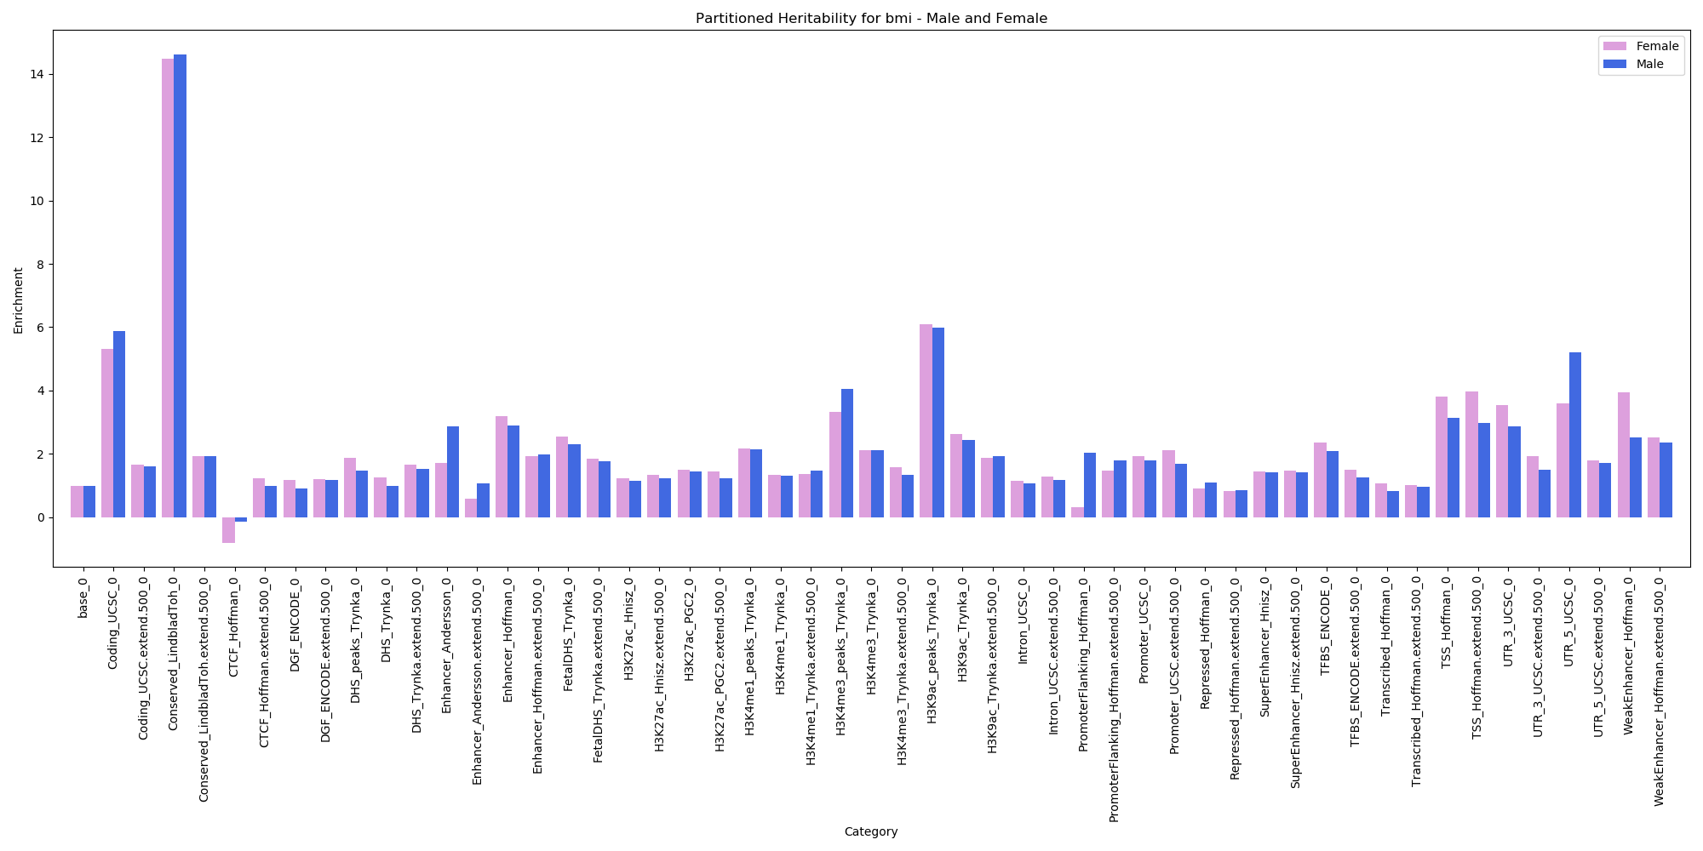
Partitioned Heritability – BMI – Male and Female

Slide 14
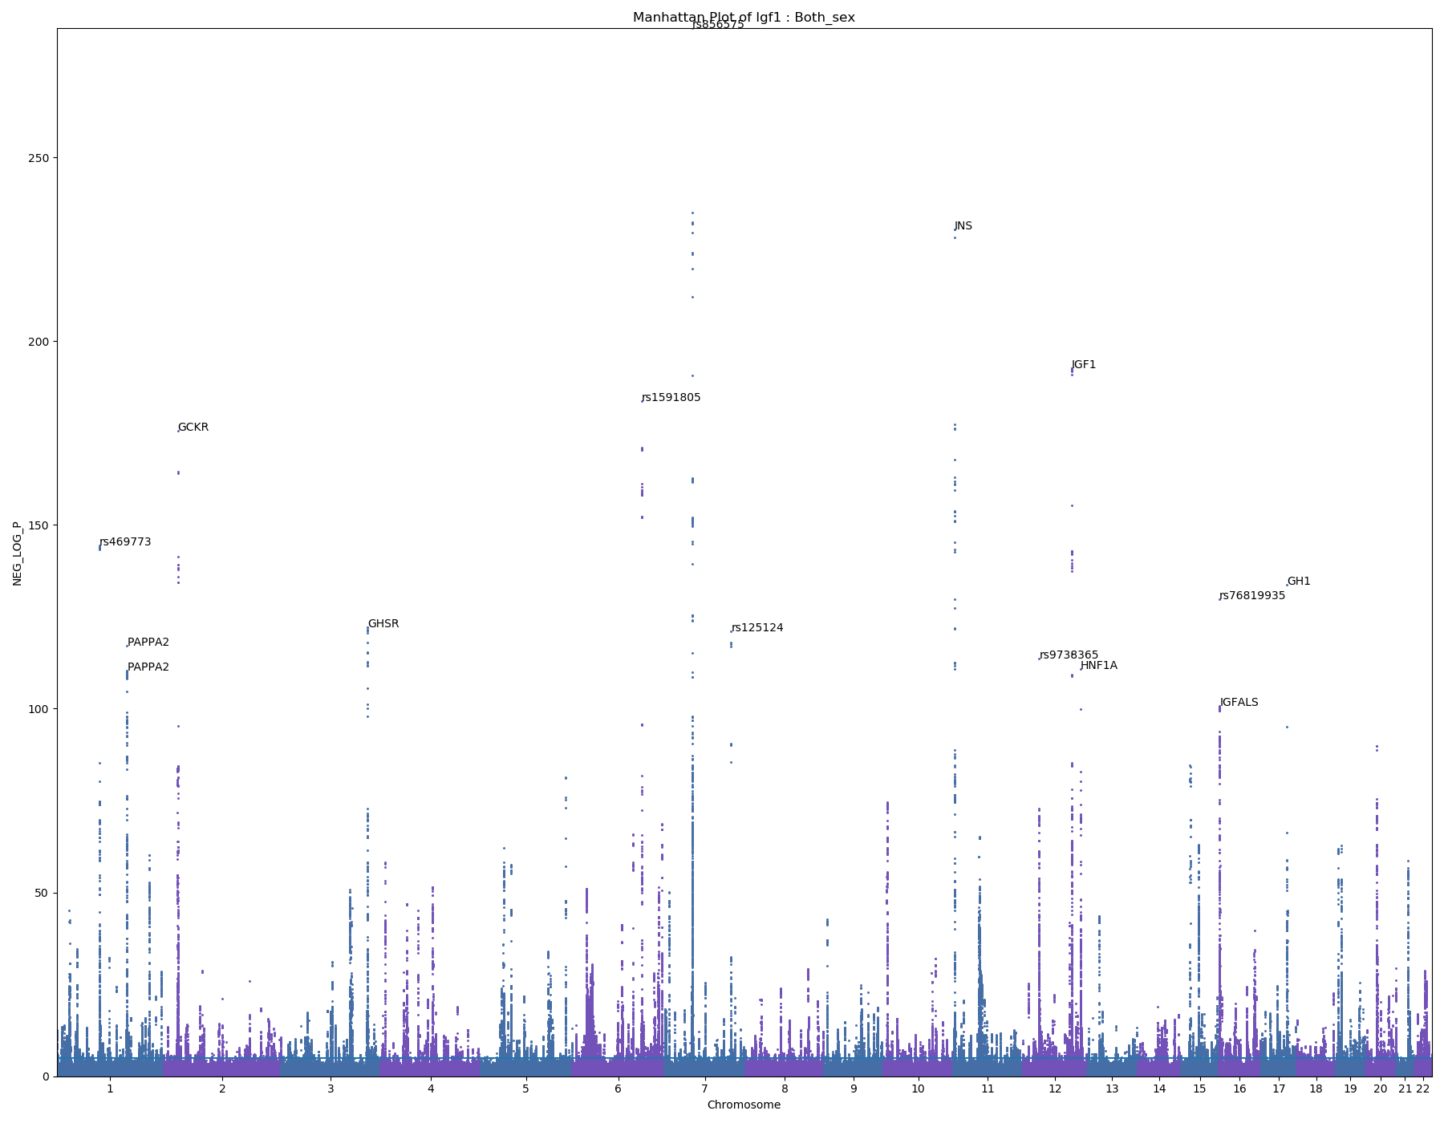
IGF-1
407974 samples
Paper:
top hit is an intergenic SNP between IGFBP3 and another gene, TNS3
IGF1, IGFALS, PAPPA2, GHSR,

Slide 15
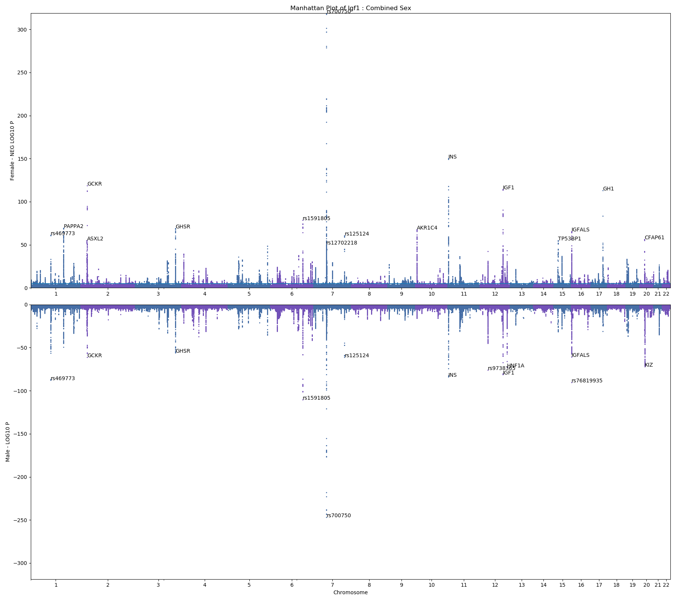
IGF-1
Female – 220671 samples
Male – 187303 samples

Slide 16
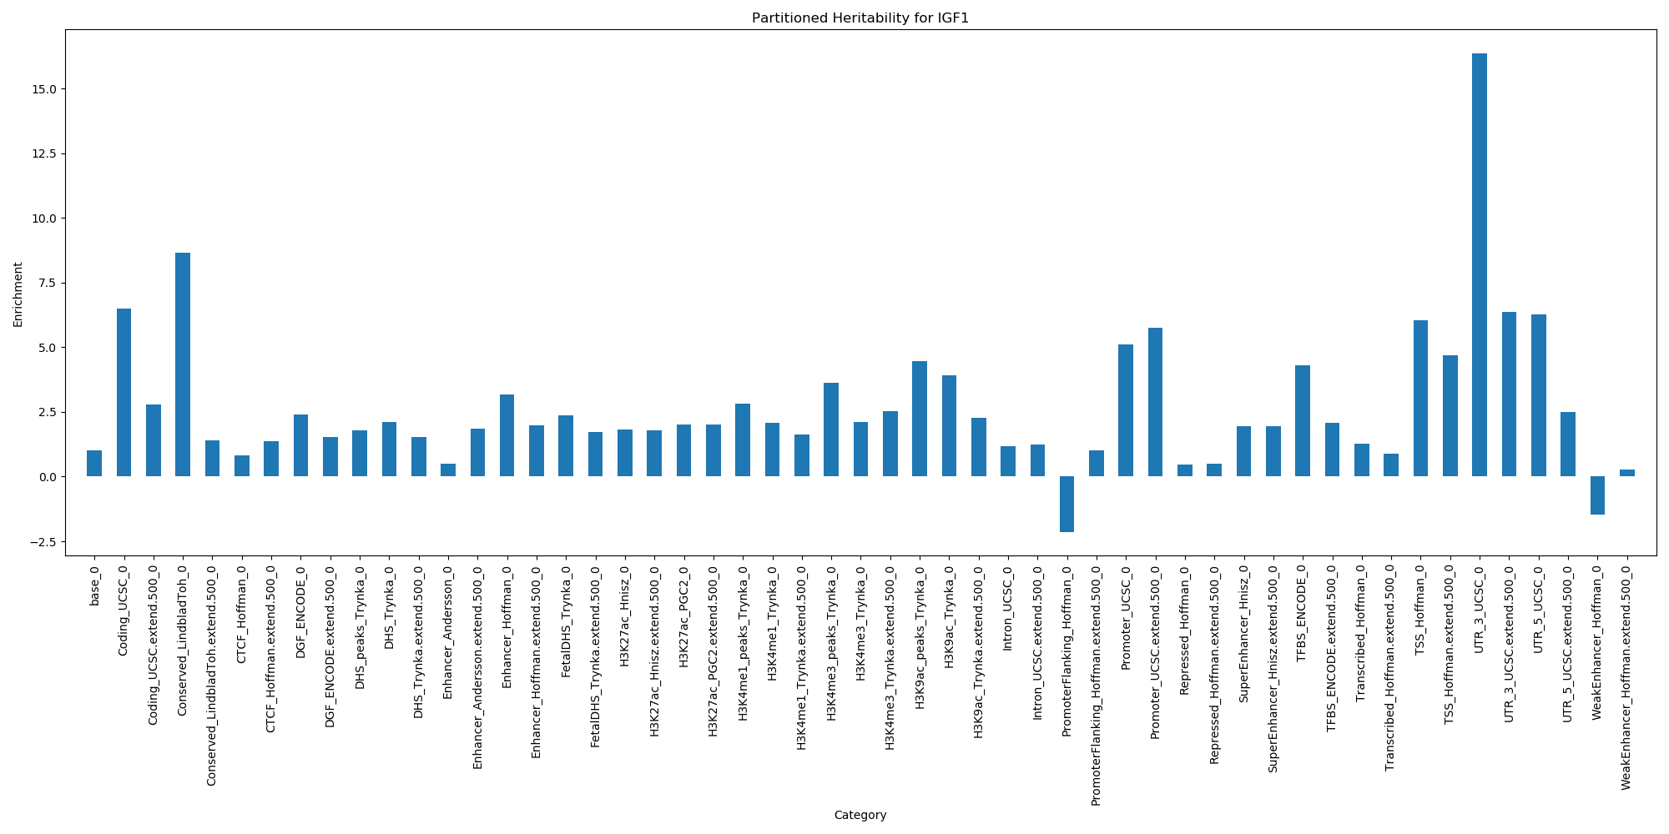
Partitioned Heritability – IGF-1

Slide 17
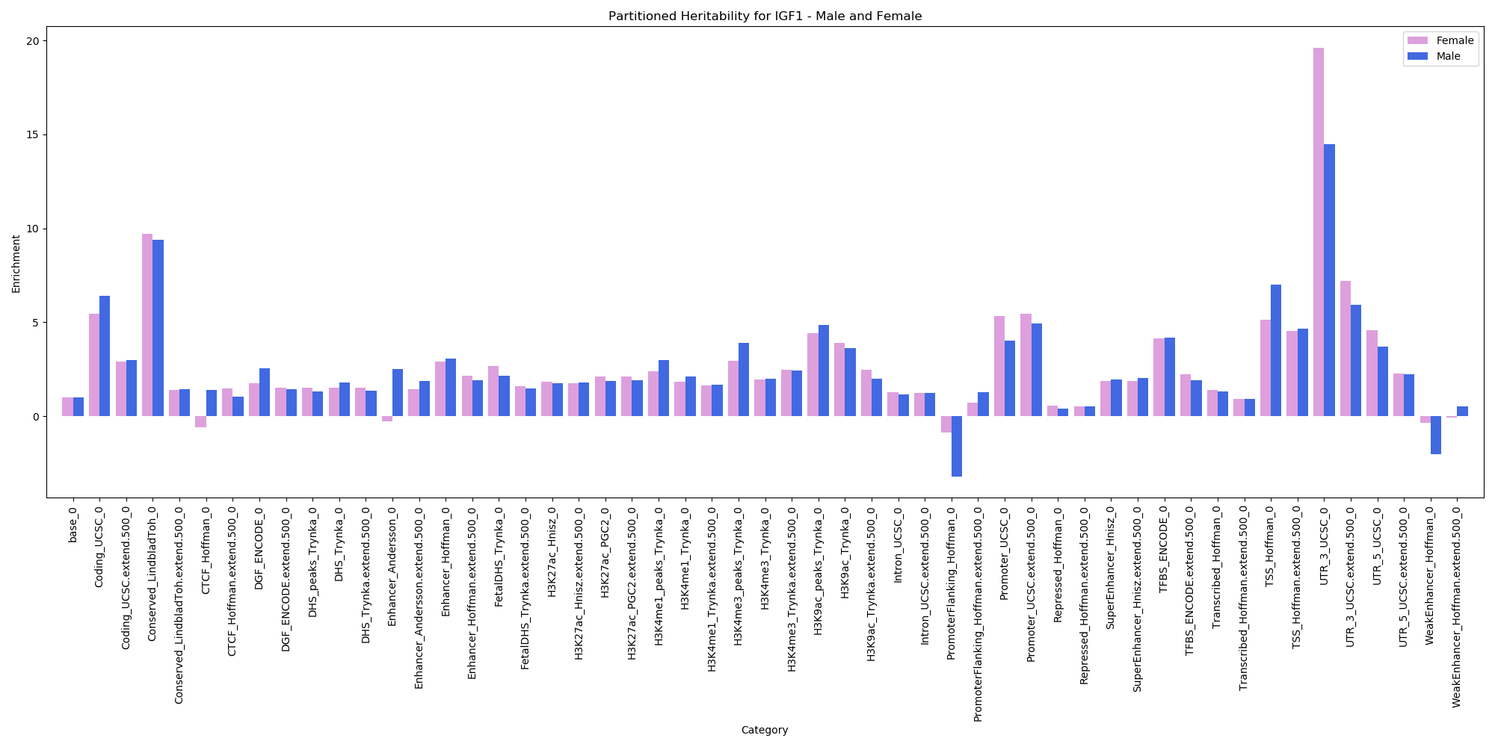
Partitioned Heritability – IGF-1 – Male and Female

Slide 18
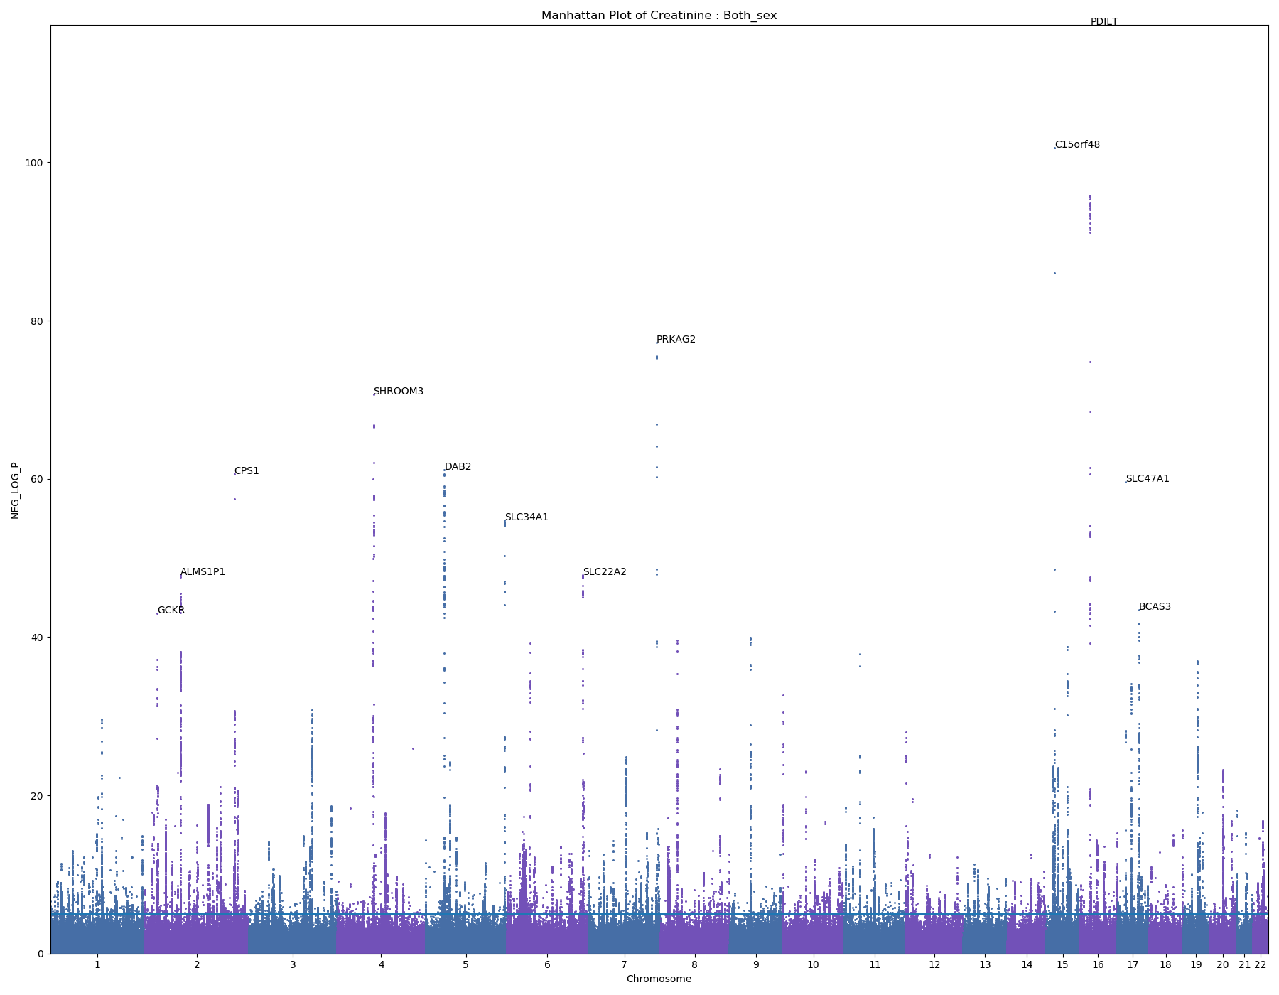
Creatinine
409989 samples

Slide 19
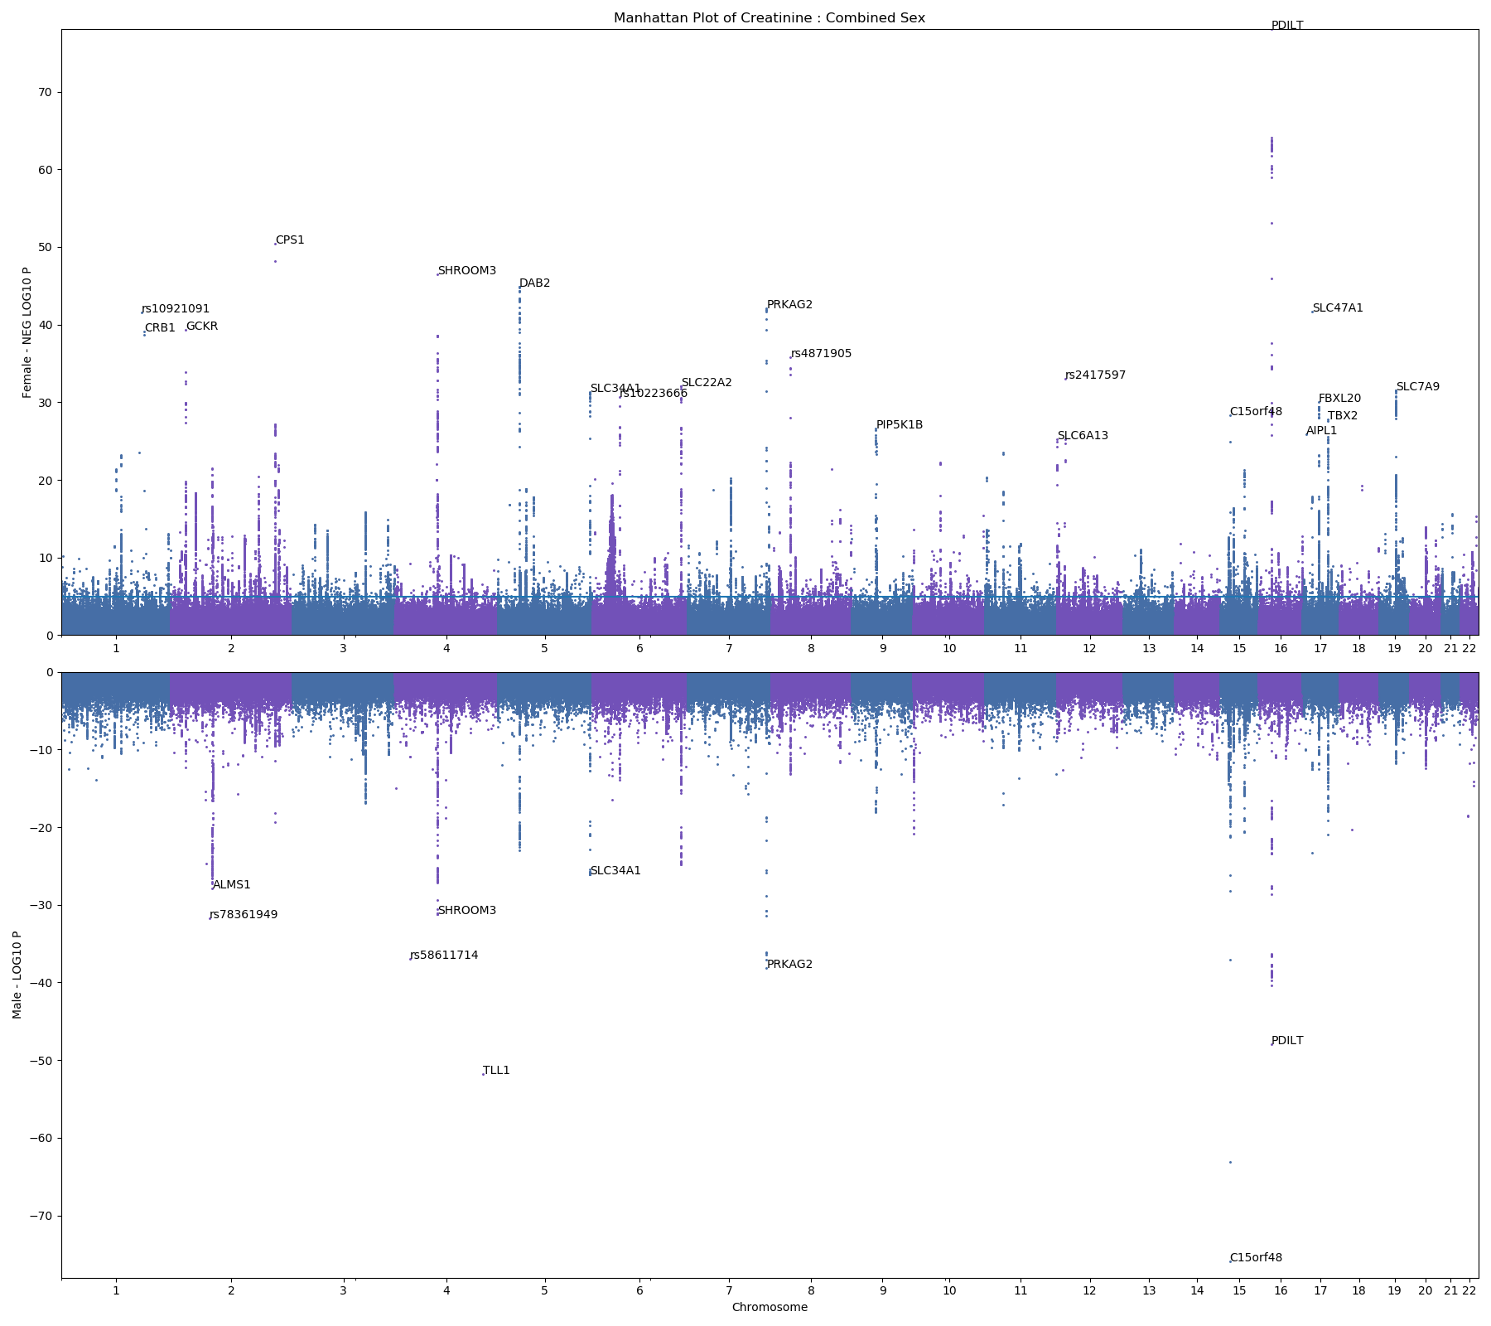
Creatinine
Female – 221802 samples
Male – 188187 samples

Slide 20
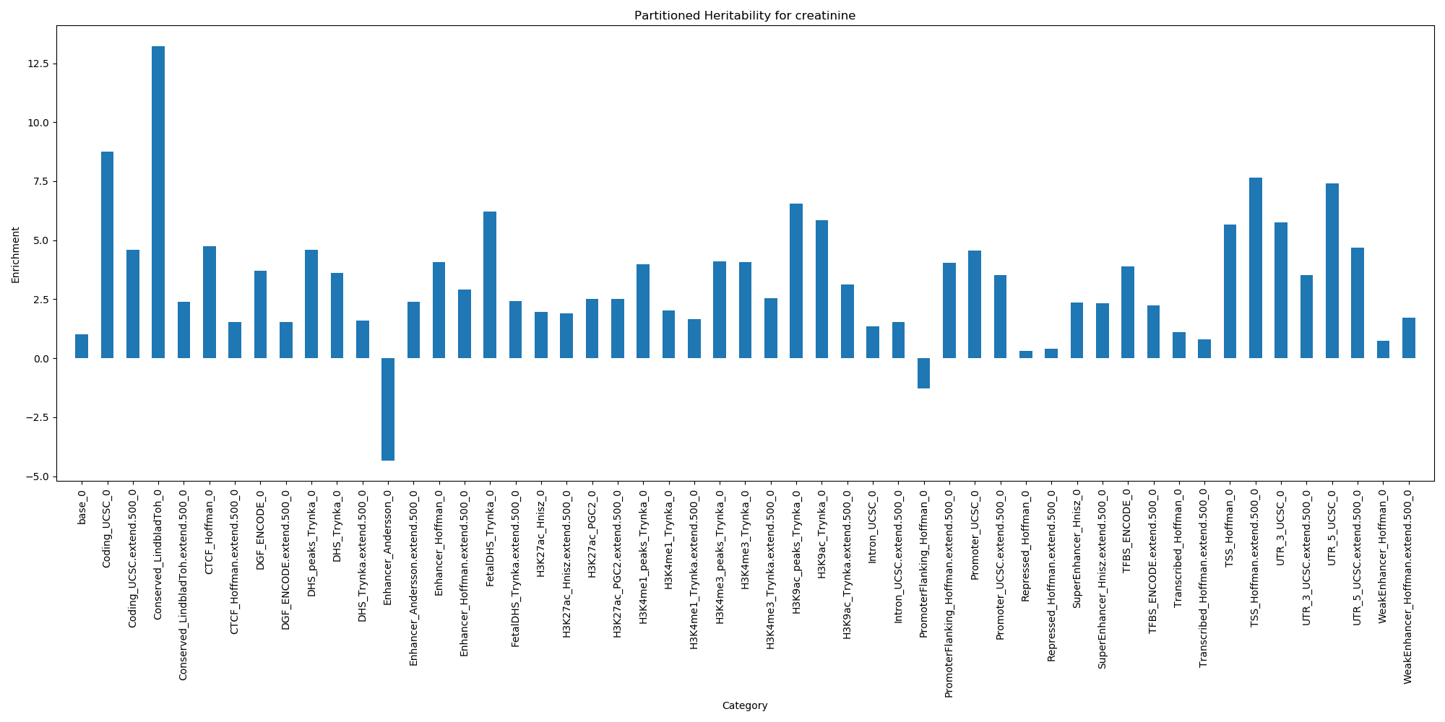
Partitioned Heritability - Creatinine

Slide 21
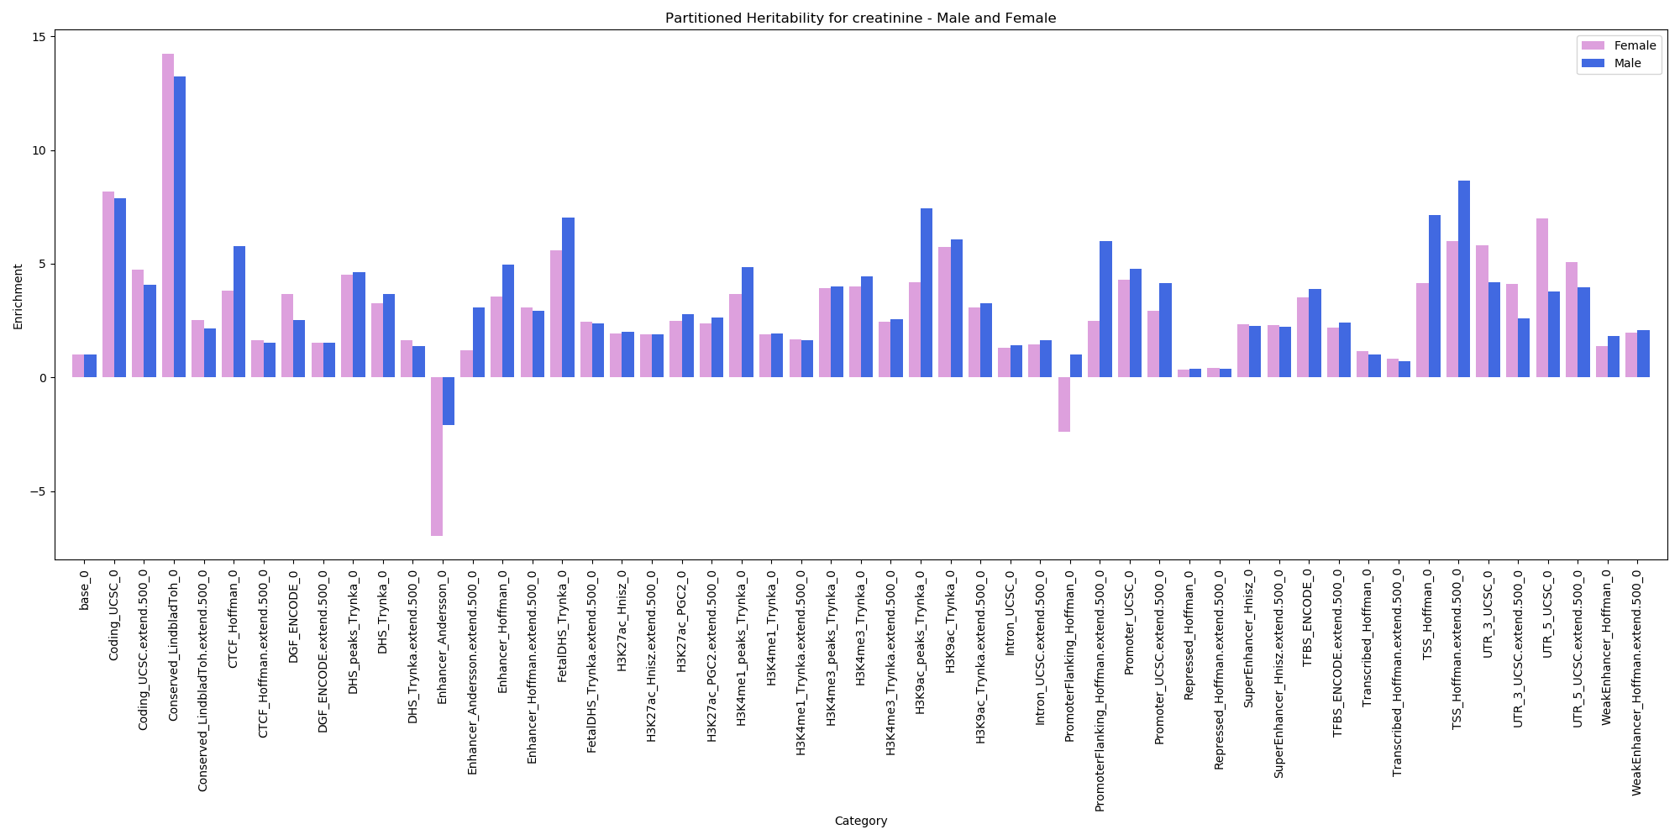
Partitioned Heritability – Creatinine – Male and Female

Slide 22
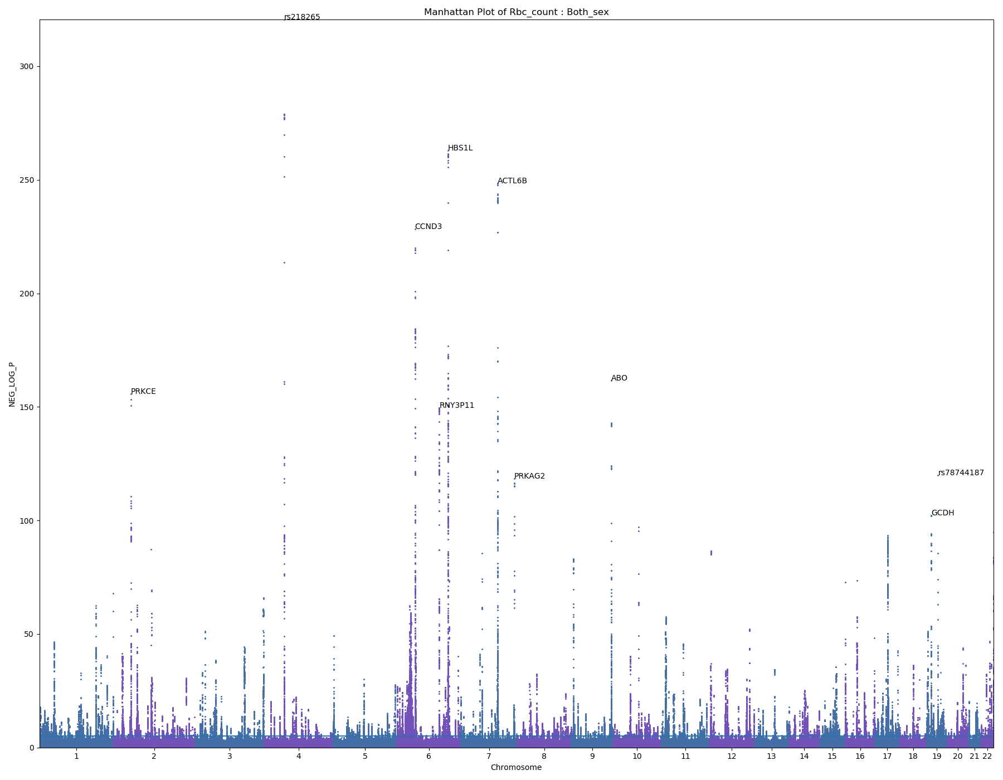
RBC Count
417360 samples

Slide 23
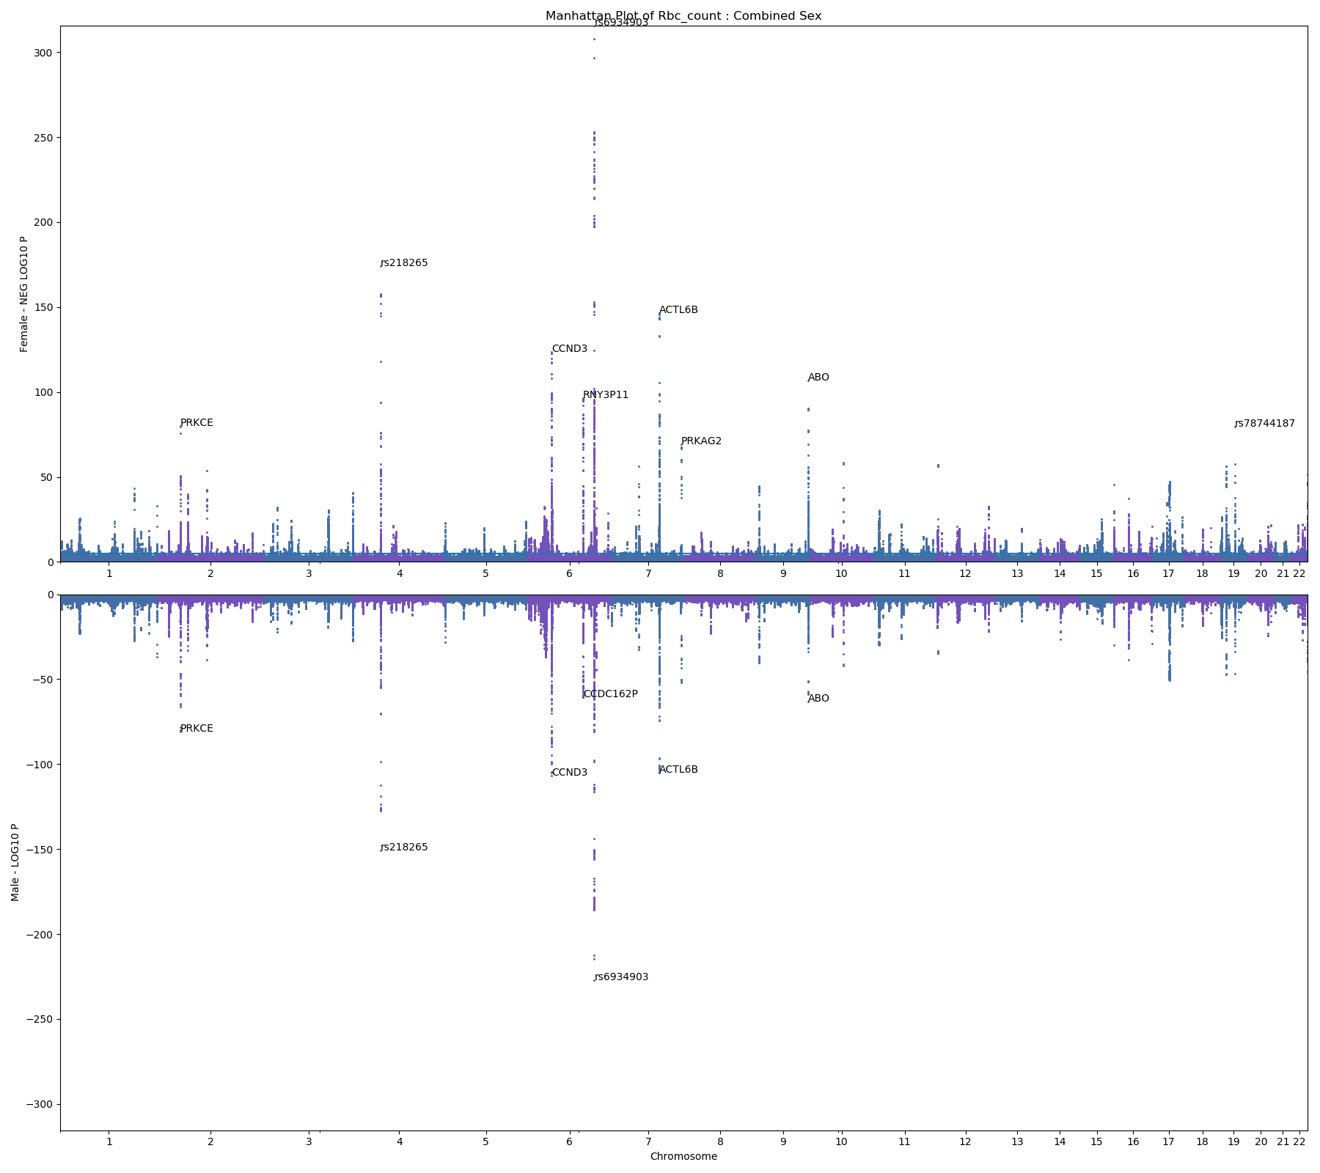
RBC Count
Female – 225432 samples
Male – 191928 samples

Slide 24
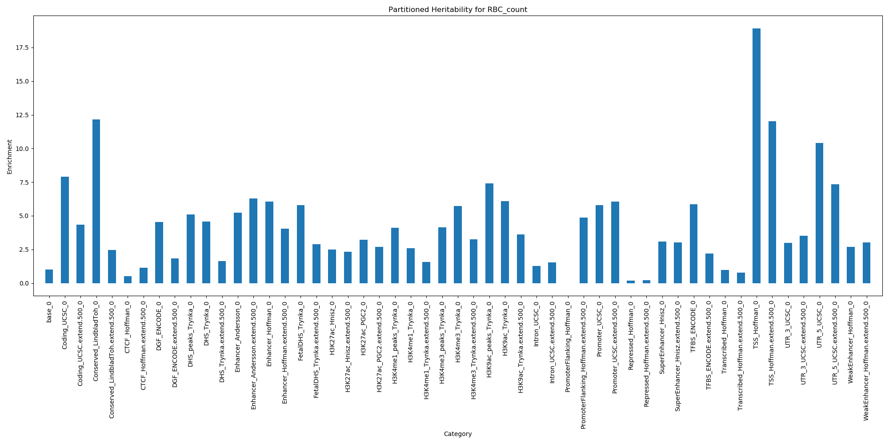
Partitioned Heritability – RBC Count

Slide 25
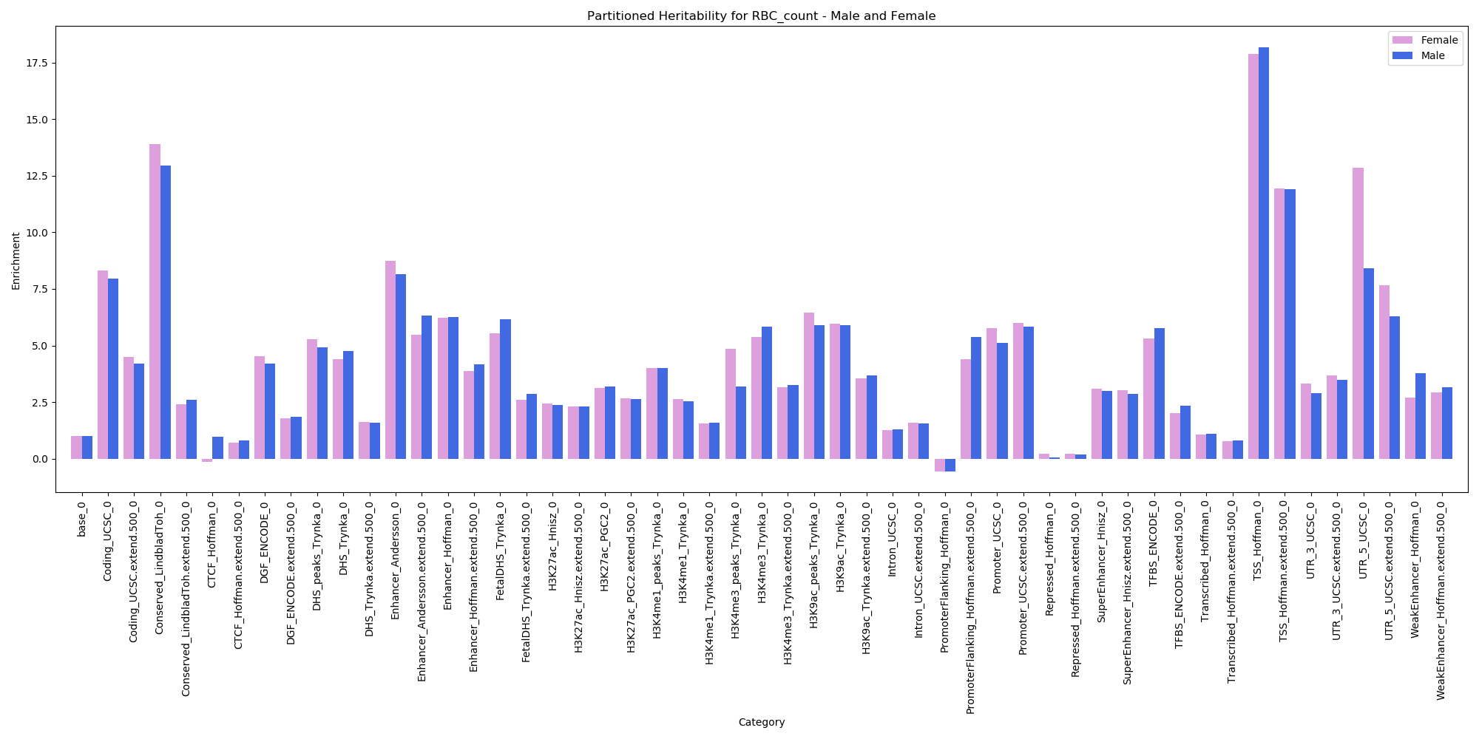
Partitioned Heritability – RBC Count – Male and Female

Slide 26
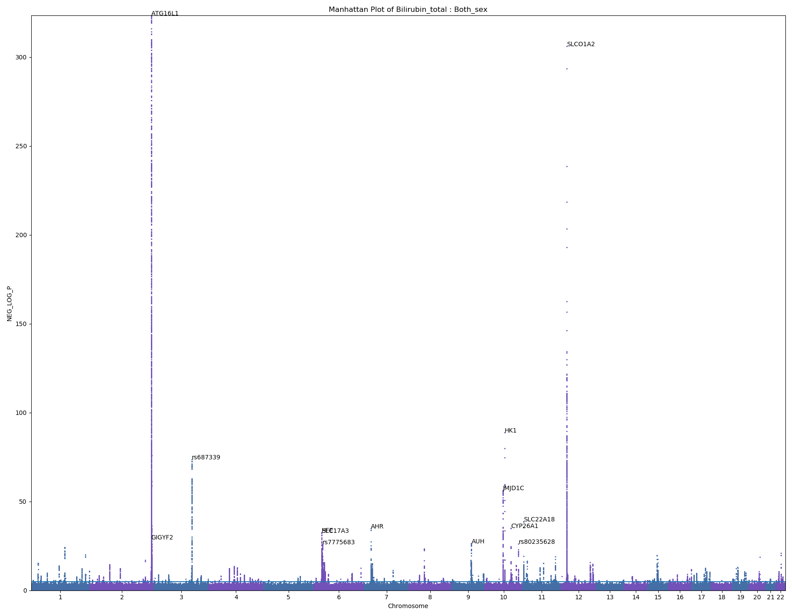
Total Bilirubin
408496 samples
ATG16L1: IBS, Crohn’s disease, increased bilirubin levels
SLCO1A2: gallstones (hardened bile)
Paper: UGT1A1: Gilbert’s syndrome (hyperbilirubinemia)

Slide 27
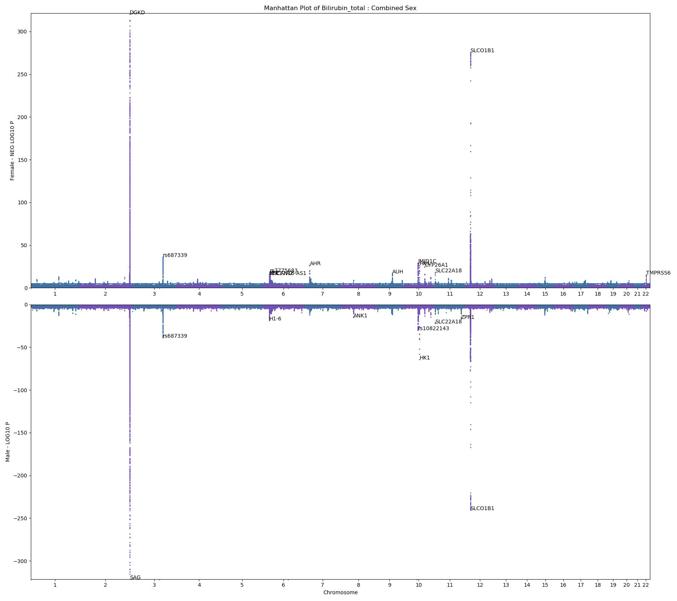
Total Bilirubin
Female – 220999 samples
Male – 187497 samples

Slide 28
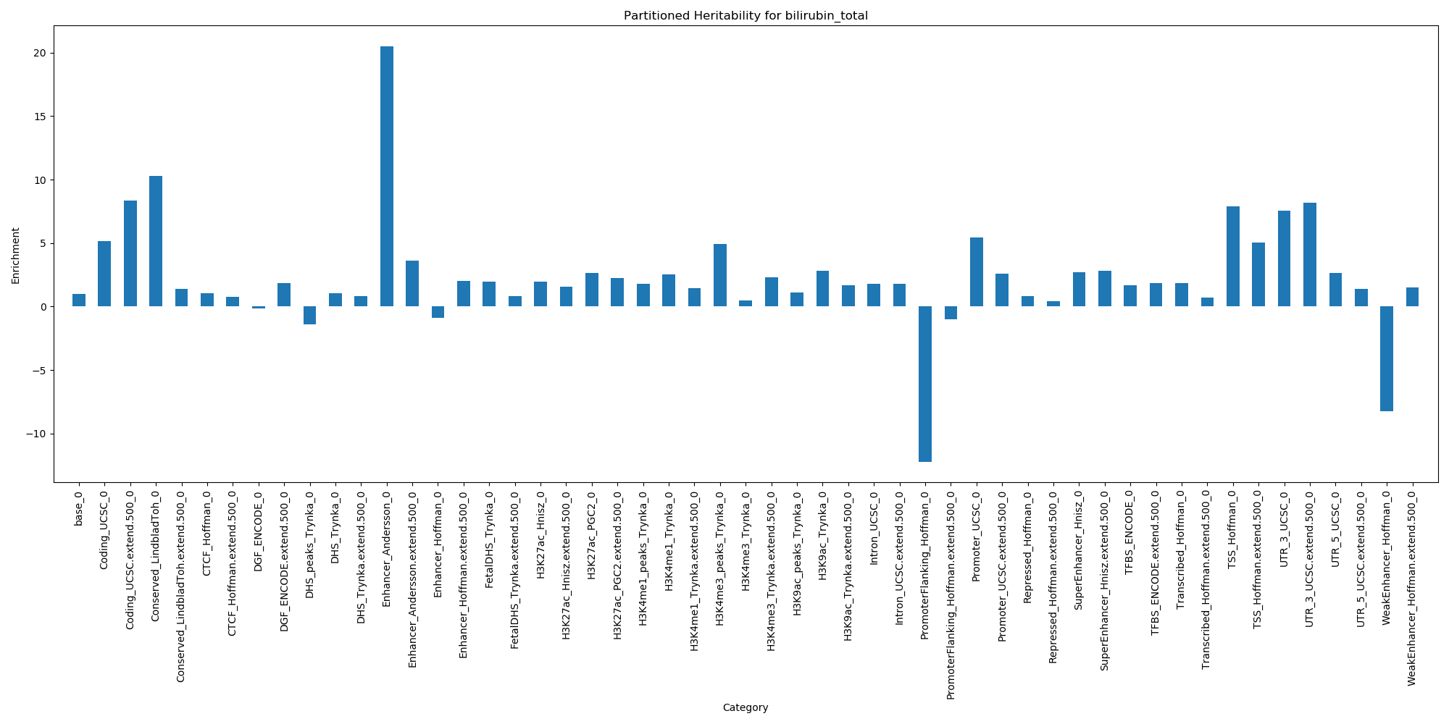
Partitioned Heritability – Total Bilirubin

Slide 29
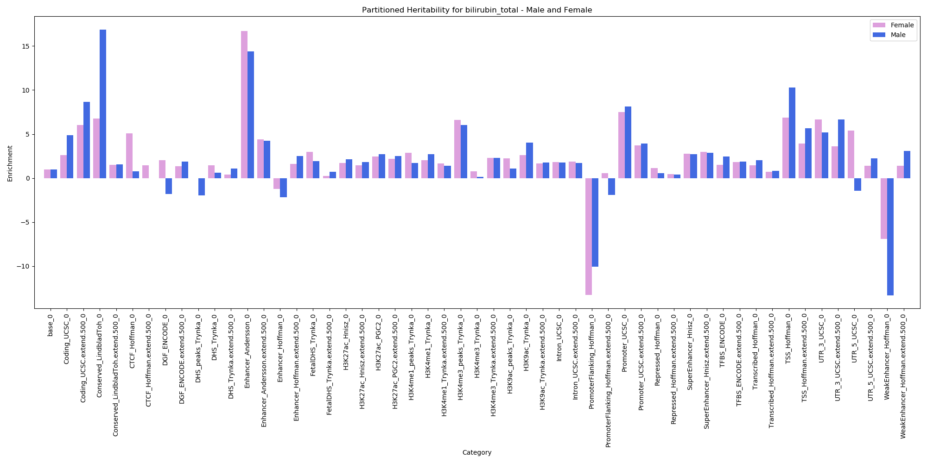
Partitioned Heritability – Total Bilirubin – Male and Female

Slide 30
LDSC
GWAS |  | My LDSC |  | Correlation | Actual Neale
Phenotype | Sex | Heritability | Intercept | Correlation | Heritability | Intercept
Height | Both | 0.419 | 1.6768 | 0.9723 | 0.485 | 1.313
 | Female | 0.4298 | 1.3777
 | Male | 0.434 | 1.309
Testosterone | Both | 0.0815 | 1.0731 | 0.0156 | 0.0771 | 1.062
 | Female | 0.0506 | 1.0385
 | Male | 0.166 | 1.0725
BMI | Both | 0.2275 | 1.2145 | 0.9272 | 0.248 | 1.105
 | Female | 0.2422 | 1.0961
 | Male | 0.2563 | 1.0774
IGF-1 | Both | 0.1987 | 1.2771 | 0.8919 | 0.253 | 1.125
 | Female | 0.2032 | 1.1672
 | Male | 0.2382 | 1.1193
Total Bilirubin | Both | 0.0786 | 1.0891 | 0.9815 | 0.543 | 0.7779
 | Female | 0.0944 | 1.056
 | Male | 0.0942 | 1.0458
Creatinine | Both | 0.0954 | 1.1313 | 0.897 | 0.211 | 1.093
 | Female | 0.1264 | 1.0819
 | Male | 0.0909 | 1.0629
RBC Count | Both | 0.1839 | 1.3098 | 0.951 | 0.234 | 1.156
 | Female | 0.2026 | 1.1803
 | Male | 0.1831 | 1.1162
Notes:
Sex-specific paper:
Testosterone genetic correlation: 0.120

